Slide 1



Slide 2

Live Stock Supervision
Supervised by:
Group Members:
Department of Computer Science
COMSATS University Islamabad, Attock Campus

Slide 3
Outline
Introduction
Working flow
Comparison table
Problem statement
Objectives
Interface
Methodology
Modern tools
Benefits
References
_______________________________

Slide 4

Introduction
Live Stock Supervision is android based app which helps to customer to choose good and recommended feed for animal according to the weather.
The trending feed will be recommend based on locality.
Consultant provide their service to customer.
Customer can be contact and track nearest Consultant. It will be give 100% accuracy because of Google Map Tracking.
Customer can be communicate through app with customer.
Shopkeeper provide their service to customer to sale his feed .Customer can be report and test it by provide this feed to customer.
_______________________________

Slide 5
Continue..
The customer can be track shop if he want to visit.
Online delivery module will be added
Reports are entertain
Account are enable and disable on the basis of complain. These decision take by system by check their activities

Slide 6
Customer and consultant can be communicate through live chat and live call by system.
Customer will rate the products (Feed).
Customer will rate consultancy.

Slide 7
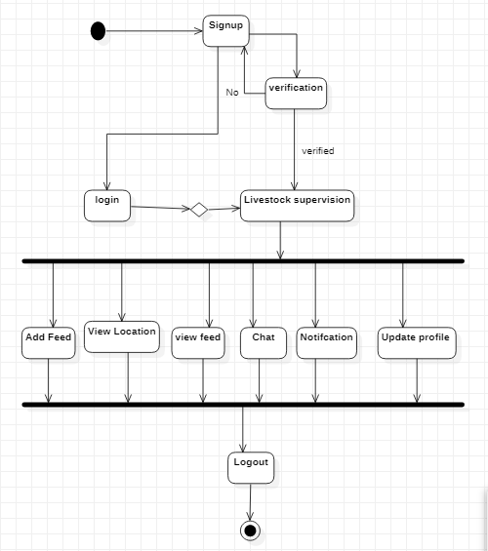
Shop Keeper Work Flow
_______________________________

Slide 8
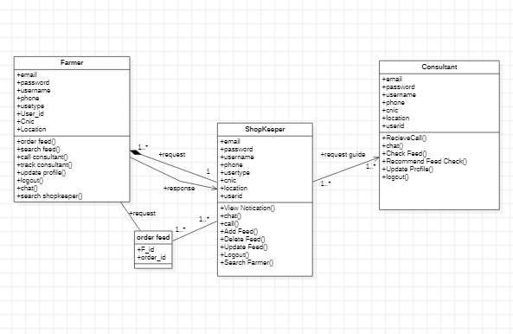
Class Diagram

Slide 9
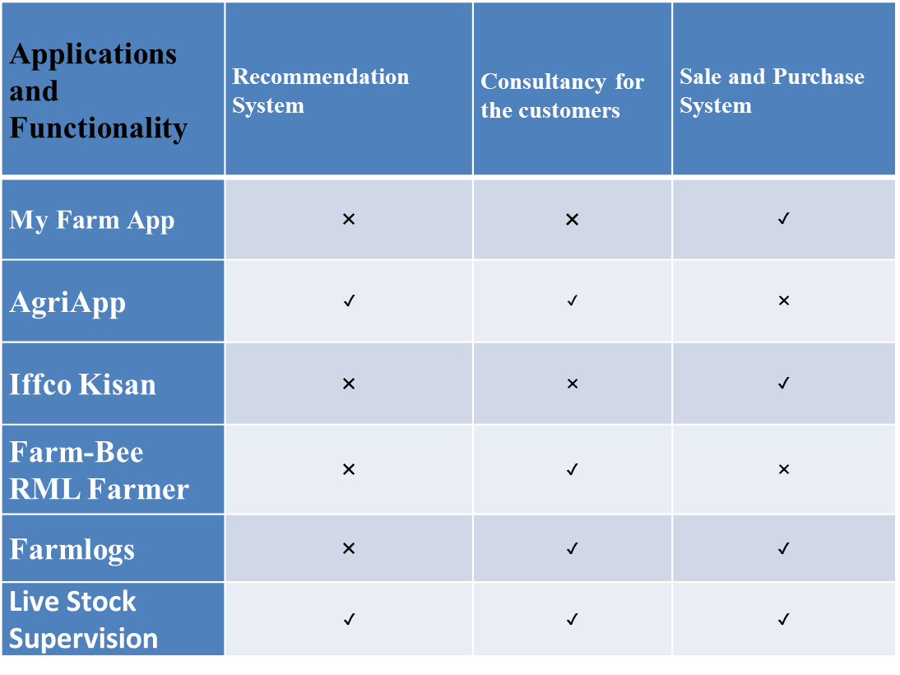
Applications And Comparison Table

Slide 10
Problem statement
For putting in any requests they need to visit the feed shop and buy it in various Cities. In Some villages there is no feed shop to buy them
For taking guidance they need to visit and hang tight for an advisor for exhortation.
There is another issue identified with taking care of there is exceptionally hard to track down moving feed as per place.
_______________________________

Slide 11
Objectives
This application for farmer and shopkeeper without wasting time, an app allowed to hire a feed item from shopkeeper when required, and famer easily online find and track place.
The farmer and the shopkeeper can check reviews about the new items at any order to judge performance with the help of other user’s feedback.
To build up an application that will surely satisfy the shopkeeper and managed a large number of orders or requests at a time accepted (one after another).
To develop an effective and efficient application for different users.
_______________________________

Slide 12
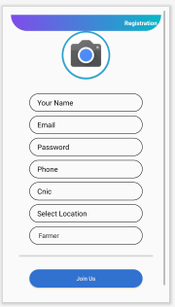
Registration interface
_______________________________

Slide 13
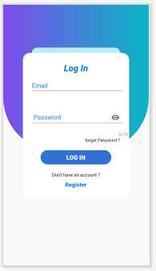
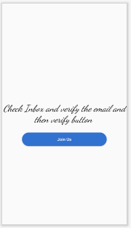
Login Activity
Check Credentials
_______________________________

Slide 14
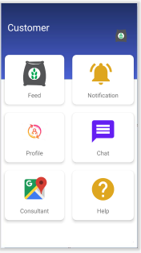
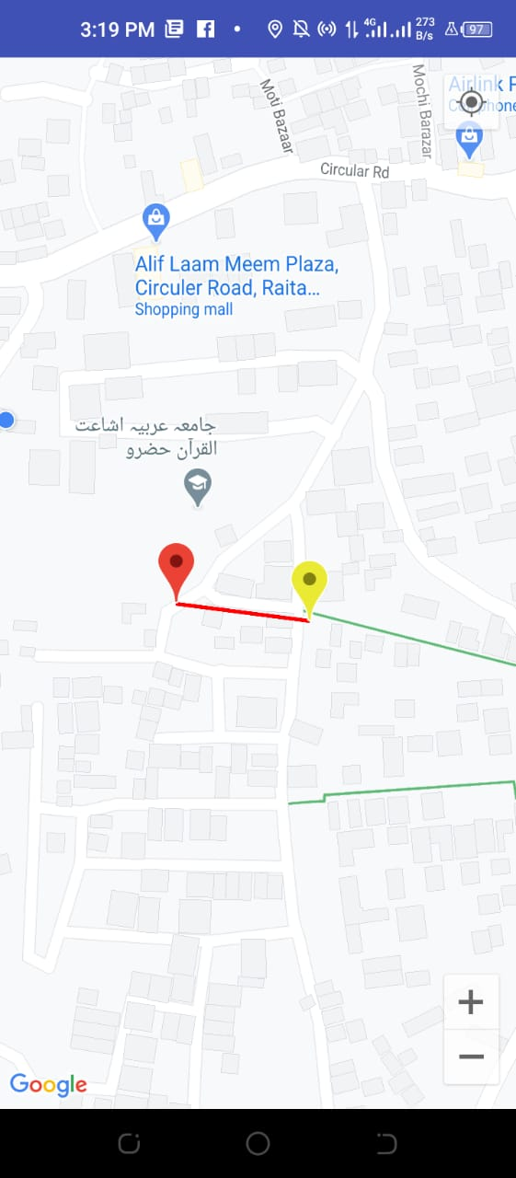
Dashboard
Location
_______________________________

Slide 15
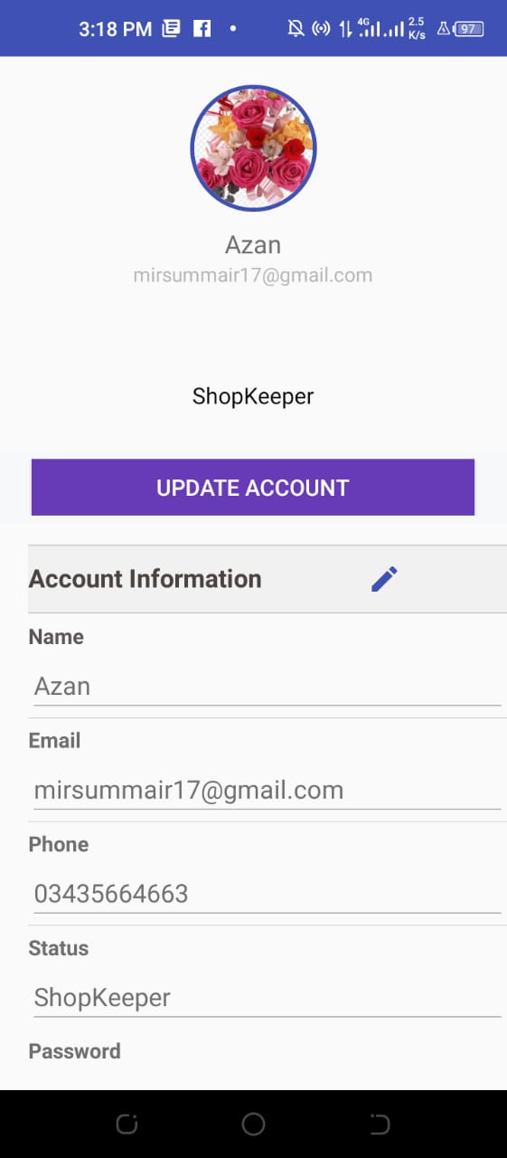
Profile
_______________________________

Slide 16
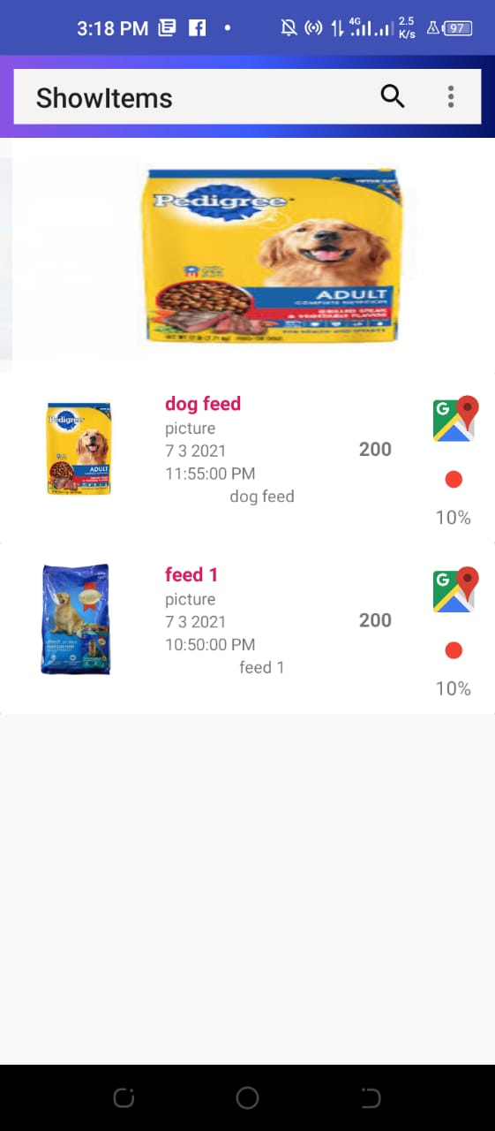
Show item Feed
_______________________________

Slide 17
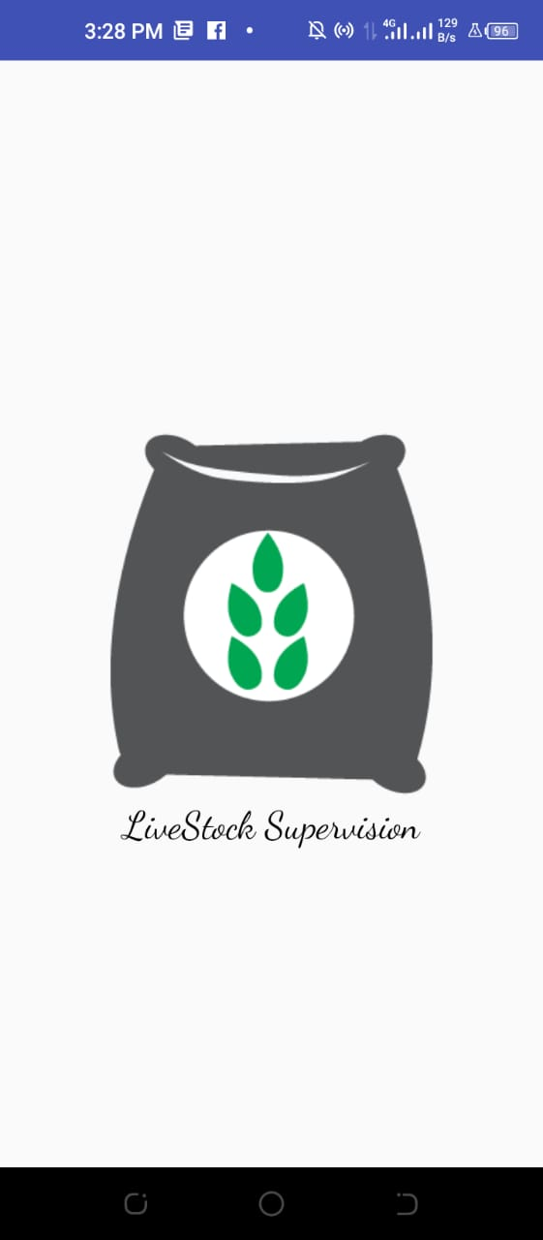
Splash Screen
_______________________________

Slide 18
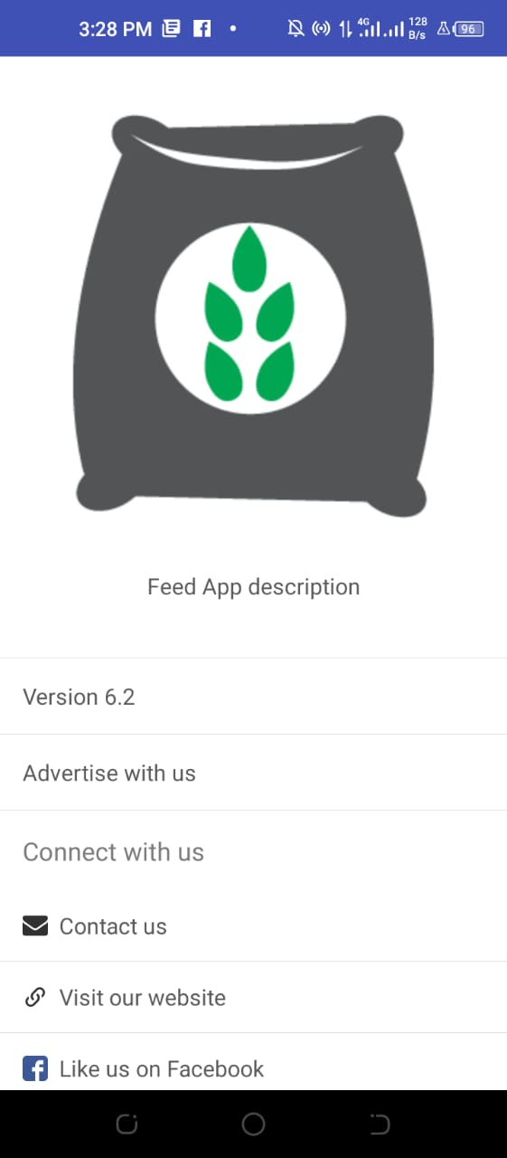
About us
_______________________________

Slide 19
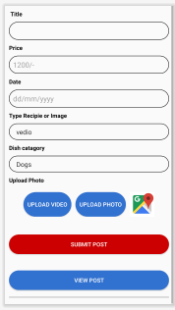
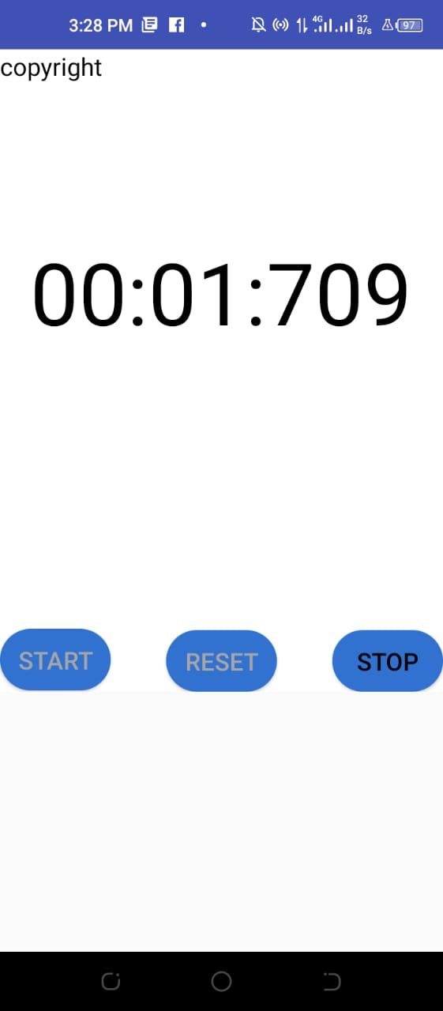
Upload Feed Shop Keeper
Stop Watch
_______________________________

Slide 20
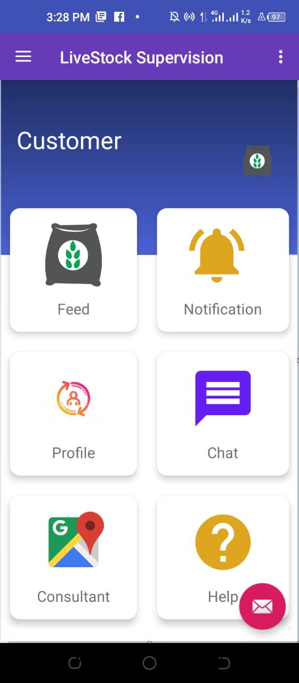
Customer Dashboard
_______________________________

Slide 21
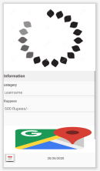
Place Order Activity

Slide 22
Development Requirements
Software Requirements dependence:
IDE: Android Studio 3.5Programming language: java , XML , Python
Database: Firebase Database
Algorithm : collaborative and content filtering
Tools: Android Studio
JDK
SDK
Hardware Requirements dependence:
Smart Mobile Phone: Android Studio

Slide 23
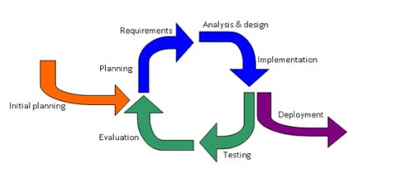
Rationale behind Selected Methodology
Selection of this methodology as we are developing in increment forms so if change require after result showing to supervisor.
Can easily get break point so we able to change as supervisor tells us plus to take a look on sensors reading as they should be accurate that doctor will get.
_______________________________

Slide 24
Modern tools
Tools | Version | Rationale
Android studio | 4.2 | IDE
Firebase | 2021 | DBMS
Adobe Photoshop | CC 2021 | Design Work
MS Word | 2013 | Documentation
MS Power Point | 2013 | Presentation
Adobe XD | 2.1.32 | Mockups Creation
Technology | Version | Rationale
XML, Java | 6.0 | Programming language
python | 3.9 | programming language
Mini_conda | 3,9 | interpreter
_______________________________

Slide 25
Benefits
    Time-Saving:
The guideline base is on time since time is what we need most, yet we use the most perceptibly awful. Solicitation Feeds for animal online through an application is additionally a viable other alternative, particularly at whatever point the user don't get the opportunity to visit a shop. Through the application, the solace for Farmer has extended an incredible arrangement realted to take care of which are moving on base of region and animal, the user can orchestrate feed in minutes, get it passed on to ythe home, and eat at the solace of ythe place, and furthermore to accept brisk guidance realted to animal effectively and productively.
_______________________________

Slide 26
Continue…
    Reliability:
It's a reliable stage where people can speak with each other concerning their Farmer and money manager to arrangement and buy feed. Here Farmer will have a feeling of security and straightforwardness to look at an issue with consultant and interest online adequately
    Efficient
If there is any problem or query to any farmer, he/she can directly contact to us we will efficiently reply in about half-hthe and solve their queries.

